Slide 1










Social Media Analytics Network Centrality Metrics MSBA, Session 3, Jan 28, 2022
Dr. Anitesh Barua
David Bruton Jr. Centennial Chair Professor of Business
Distinguished Fellow, INFORMS Information Systems Society
University of Texas Distinguished Teaching Professor
Associate Director, Center for Research in e-Commerce
McCombs School of Business, University of Texas at Austin
Email: aniteshb@gmail.com

Slide 2
Metric 2: Betweenness Centrality
Popularity (degree) is useful, but there are other roles
Connecting disparate parts of a network
How difficult will it be for others (esp. at the “outskirts”) to communicate without you in the network?
Nodes with high betweenness are important in transmitting new information, ideas & opportunities to a wide audience

Slide 3
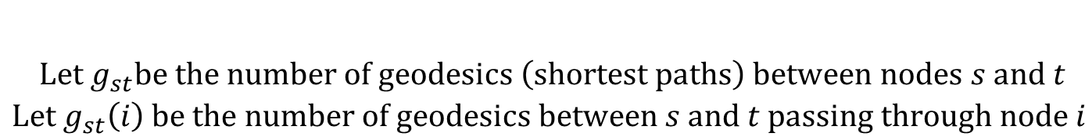
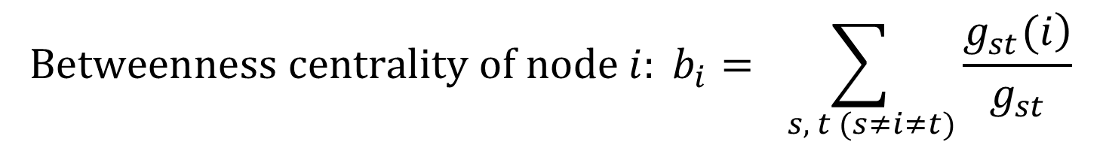
Formal Definition
$$\begin{aligned}Let g_{st}be the number of geodesics \left(shortest paths\right) between nodes s and t \\ Let g_{st}\left(i\right) be the number of geodesics between s and t passing through node i \end{aligned}$$
$$Betweenness centrality of node i: b_{i}=\sum_{ s, t (s≠i≠t)}{\frac{\left.g_{st}(i\right)}{g_{st}}}$$

Slide 4
Betweenness Centrality Example
5
2
10
1
9
7
4
 | 1 | 2 | 3 | 4 | 5 | 6 | 7 | 9 | 10
1 | -
2 |  | -
3 |  |  | -
4 |  |  |  | -
5 |  |  |  |  | -
6 |  |  |  |  |  | -
7 |  |  |  |  |  |  | -
9 |  |  |  |  |  |  |  | -
10 |  |  |  |  |  |  |  |  | -
8
3
6

Slide 5
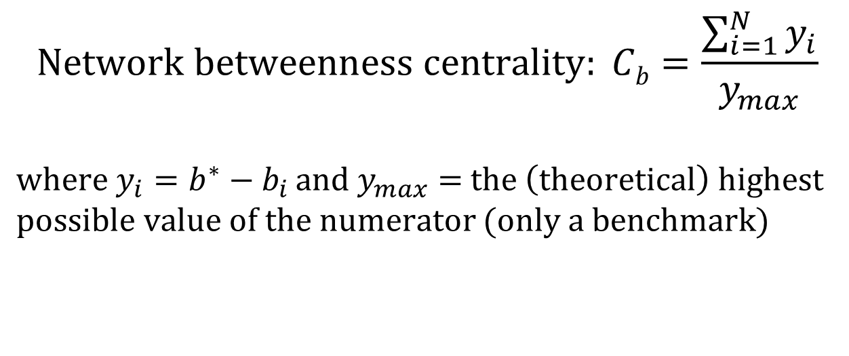
Network Level Metric
$$Network betweenness centrality: Cb=\frac{\sum_{i=1}^{N}{y_{i}}}{y_{max}}$$
${where y}_{i}=b^{∗}−b_{i }and y_{max}=$ $the \left(theoretical\right) highest$
$possible value of the numerator$ $(only a benchmark)$
What would the theoretical highest be?
For which type of a network?

Slide 6
Metric 3: Closeness Centrality
Some nodes can reach the whole network more quickly than other nodes
How close a node is to all other nodes
Create a matrix of shortest distances (geodesic) between nodes
Sum of shortest distances between a node and all other nodes
1/sum of shortest distances is the closeness centrality of the node

Slide 7
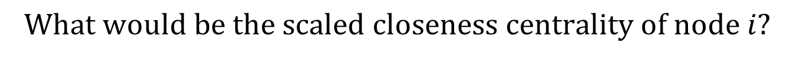
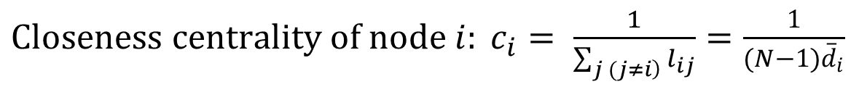
Formal Definition
${Closeness centrality of node i: c}_{i}= \frac{1}{\sum_{\left.j (j≠i\right)}{l_{ij}}}$ $=\frac{1}{(N−1){\overline{d}}_{i}}$
$$Where l_{ij} is the distance between nodes i and j.$$
$${\overline{d}}_{i} is the average geodesic length from node i to all other nodes.$$
$$What would be the scaled closeness centrality of node i?$$
$$What would be the network level closeness centrality?$$

Slide 8
Closeness Centrality Example
5
2
10
1
9
7
4
 | 1 | 2 | 3 | 4 | 5 | 6 | 7 | 8 | 9 | 10
1
2
3
4
5
6
7
8
9
10
8
3
6

Slide 9
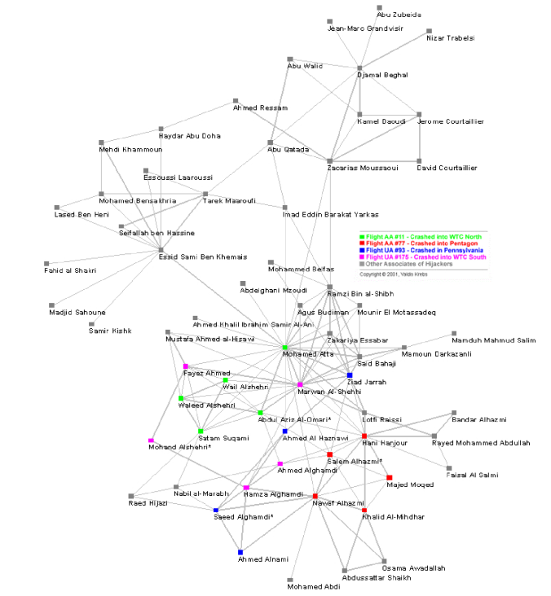
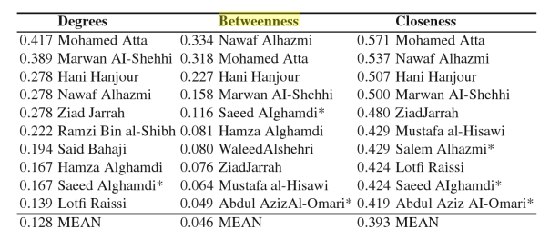
The 911 Terrorist Network Revisited
Who are central to the network?
What was the role of M. Atta?
How can we watch out against
future attacks?

Slide 10
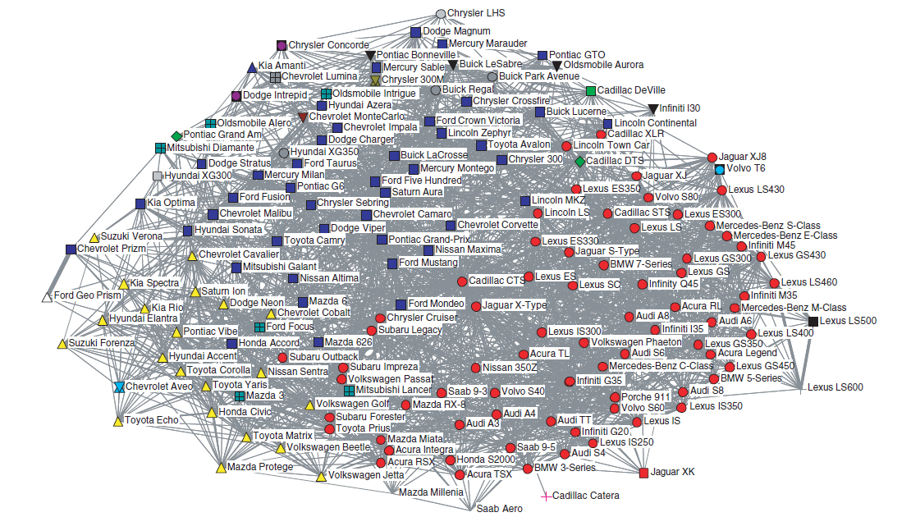
Not just People: Co-mentions of Car Models from Edmunds.com Sedan Forums
Source: Netzer et al.

Slide 11
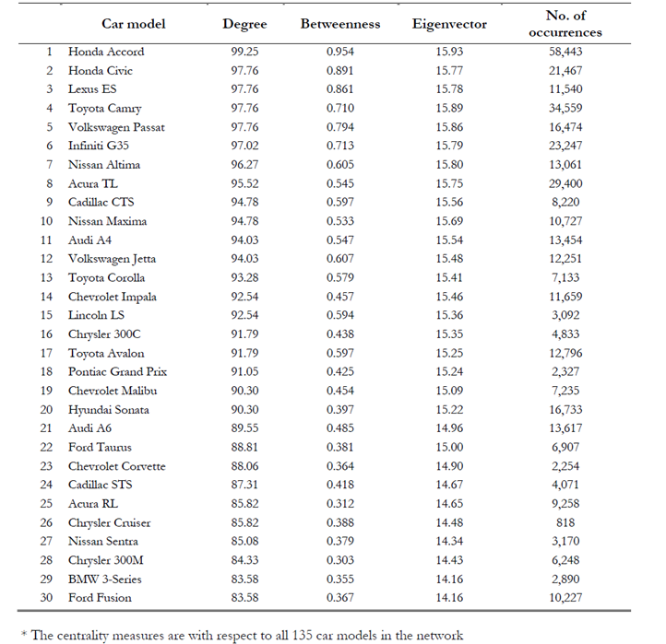
Source: Netzer et al.

Slide 12
Metric 4: Eigenvector Centrality
One’s importance is partly determined by “the company one keeps”
If one has many important friends, s/he should be important ☺
Eigenvector centrality considers not only your degree, but your friends’ degree
I.e., are your friends connected to large networks?
Google’s PageRank is closely related to Eigenvector centrality

Slide 13
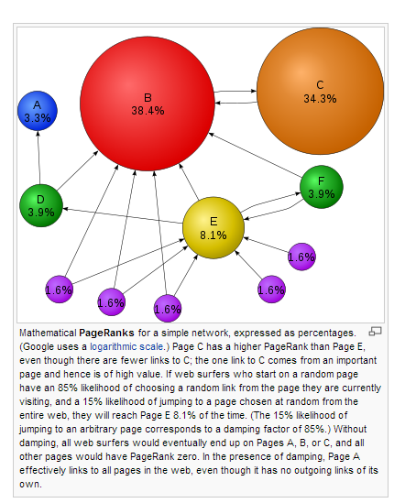
PageRank of Web Pages
If many web pages refer to a page, the latter must be important
If the referring pages are referred to by many other pages, the effect is stronger
Source: Wikipedia

Slide 14
The Original Google PageRank Algorithm
Web page x₁
Links to:
Page x₂
Page x₃
Page x₄
Web page x₃
Links to:
Page x₁
Web page x₂
Links to:
Page x₃
Page x₄
Web page x₄
Links to:
Page x₁
Page x₃
As if a page transfers its importance to other pages
E.g., x₁ transfers 1/3 of its importance to each of x₂, x₃ & x₄
Graph representation, transition matrix, Eigenvector PageRank calculation
Interpretation from a probabilistic perspective
Source: http://pi.math.cornell.edu/~mec/Winter2009/RalucaRemus/Lecture3/lecture3.html

Slide 15
The Network
X2
X1
X3
X4

